Slide 1
DATA MINING
PREDICTIVE ANALYSIS OF WINNING PLAYER IN PUBG
Members:
Pratik Utpat
Rushikesh Maheshwari
Sameera Prasad
Sanjivani Gadkari

Slide 2

Introduction
PUBG is the one of the most widely played game currently.
The game is a player versus player activity in which up to one hundred players battle in a fight, where players battle to remain the last alive.
Predict the percentile winning placement of the game.

Slide 3
Methodology(SAS Enterprise Miner)
Understanding the Data : Descriptive Analysis
Data Cleansing
Feature Engineering
Data Modeling: Regression Model, Neural Network, Decision Tree
Inference

Slide 4
Data Mining Process
Problem Definition
Data Extraction & Cleansing
Data Partition & Feature Engineering
Interpretation
Data Modeling

Slide 5
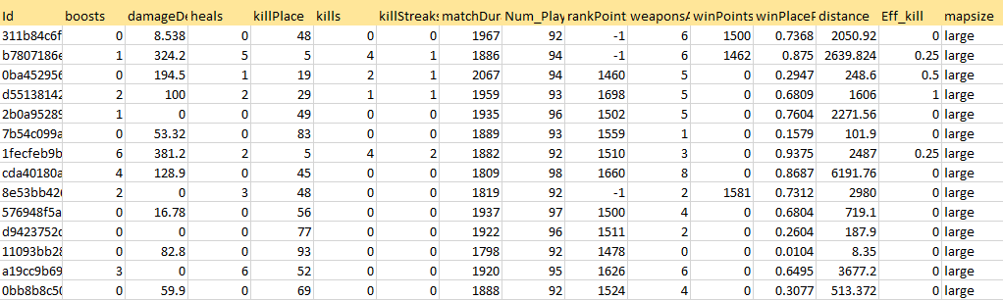
Attributes

Slide 6
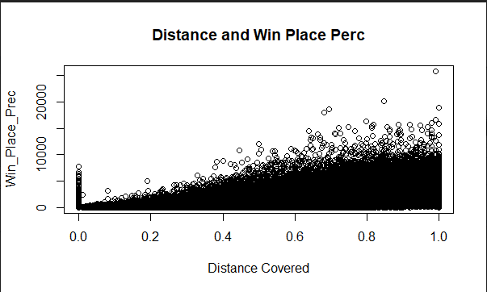
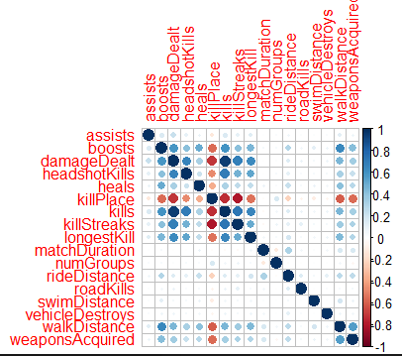
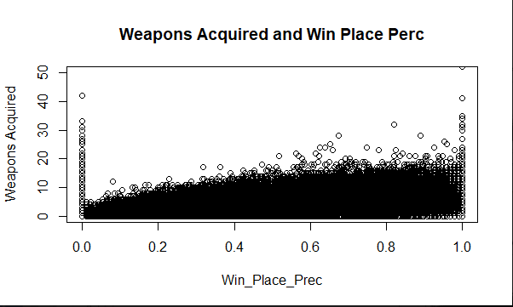
Descriptive Analysis

Slide 7
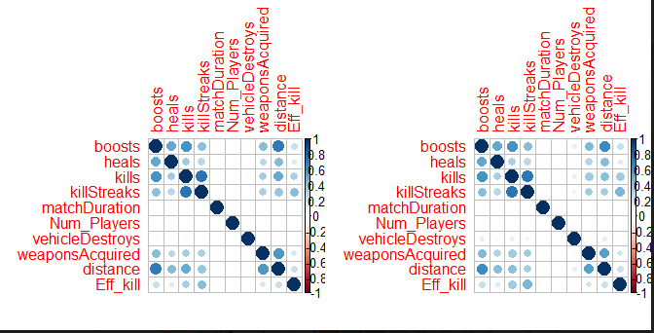

Feature Engineering
What is Feature Engineering
Why Feature Engineering?

Slide 8
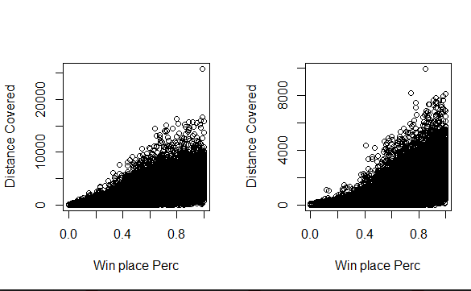
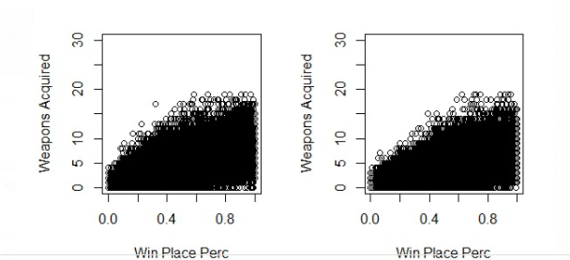
Data after Feature Engineering
Large & Small Map

Slide 9
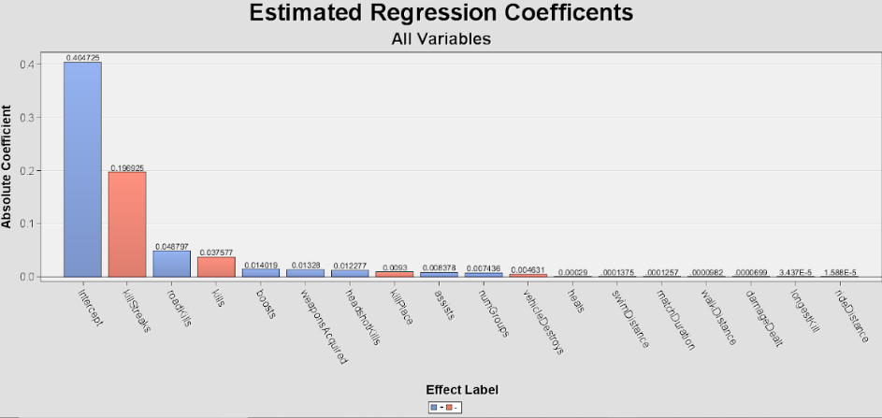

Slide 10
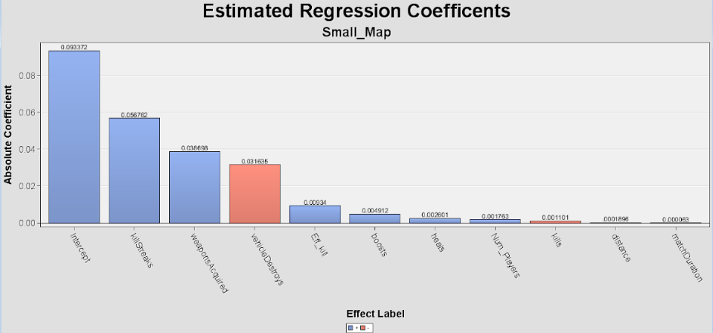
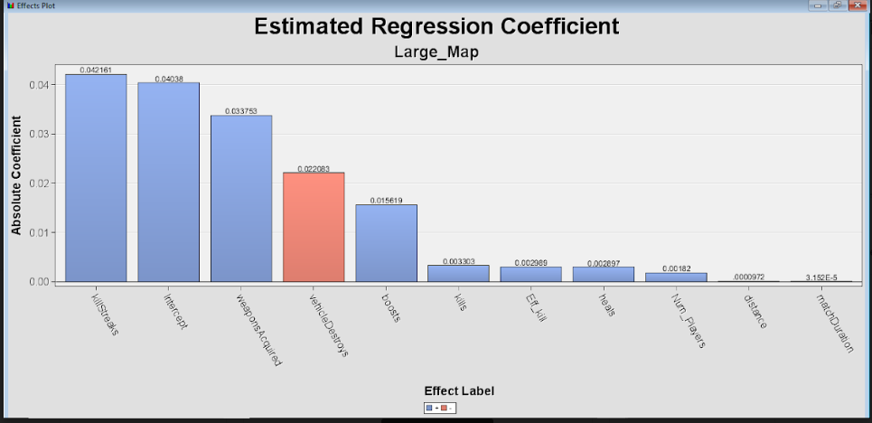

Slide 11
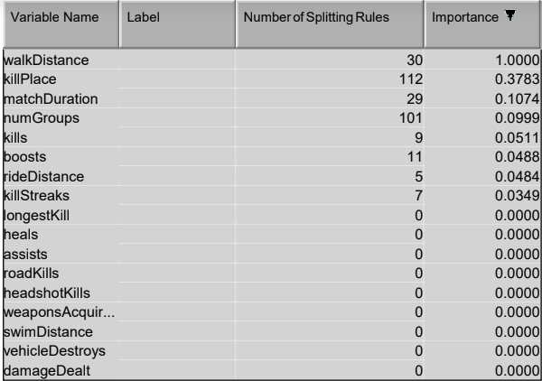
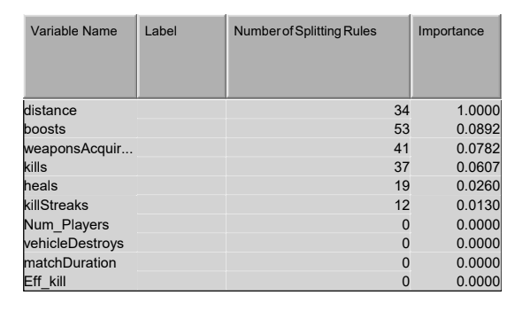
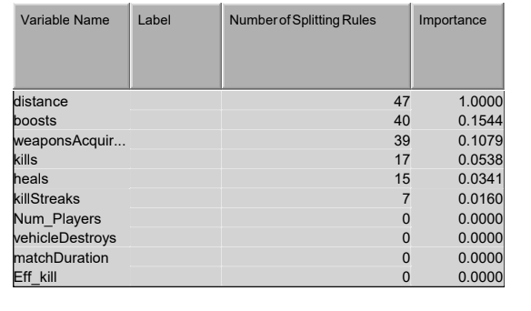
Decision Tree Variables Importance
All Variable 2. Small Map & Large Map
2.

Slide 12
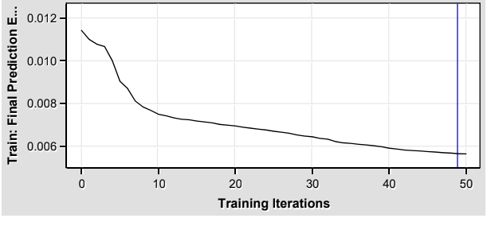
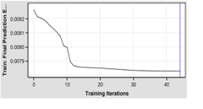
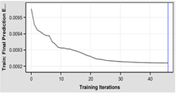
Neural Network Error Prediction
All Variables
2. Small Map 3.Large Map

Slide 13
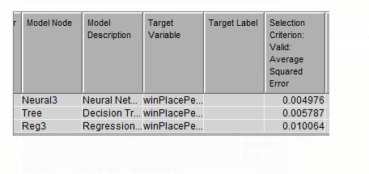
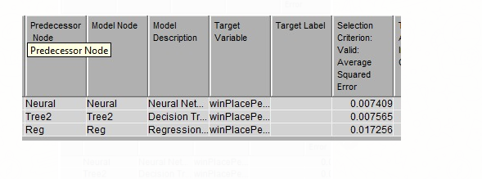
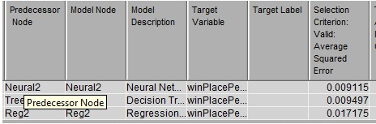
Model Results
All Variables
Small Map
Large Map

Slide 14
Inference
Variables affecting the WinPlacePerc.
Better(realistic) WinPlacePerc using feature engineering
Future Scope

